Slide 1
Business Office Forum – September 2026
Next steps after you’ve imported your payroll entry and recorded your payment for benefits:
        Reconcile your payroll liability accounts ☺

Slide 2
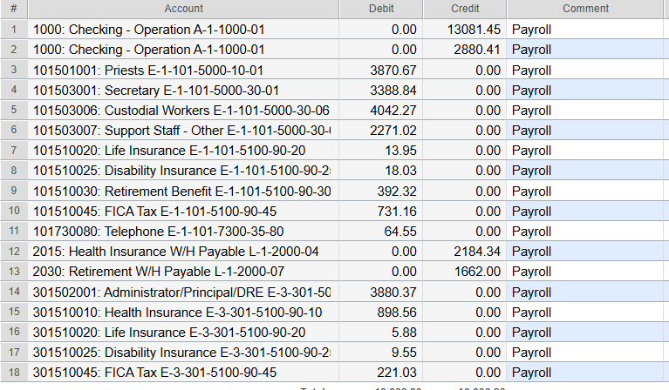
Paylocity Journal Entry

Slide 3
Explanation of Payroll Journal Entry
Credit to checking account - the top amount of $13,081.45 shows the amount withdrawn from the parish/school bank account by Paylocity for each employee’s net paycheck.
The second credit to checking of $2,880.41 shows the amount withdrawn from the parish/school bank account by Paylocity for taxes.
Lines 3, 4, 5, 6, and 14 show the expense of gross wages for the employees that are coded to these accounts in Paylocity
Lines 7, 8, 15, 16, and 17 are showing the employer paid portion of Health insurance as well as the employer paid Life insurance and Long-Term Disability. These lines show the expense being recorded.
Line 12 includes the employer paid portion of insurance benefits, plus the amounts that were withheld from the employee’s paycheck for insurance benefits. Code your benefit invoice as a debit to 2015 (excluding the fee).

Slide 4
Employer Paid Insurance Benefits
Now included on your payroll register in the section with gross wages and included in your Paylocity journal entry
All employer paid insurance benefits are now recorded to 2015 (line 12)
No need to code your ER benefits on your invoice to separate accounts
Earning Code
ERDEN | Employer portion of Dental Insurance
ERLIF | Description
ERLTD | Long Term Disability
ERMED | Employer portion of Medical Insurance
ERVIS | Employer portion of Vision Insurance

Slide 5
Account 2015 – Health Insurance W/H Payable
Reconcile monthly
Compare the benefit amounts on your payroll register to your monthly invoice (now from the Diocese rather than Assured Partners)
      Verify the correct amount is being withheld from the employee paycheck
      A balance in 2015 should clear out in a future month, typically with a retroactive adjustment (most common with new hires and terminated employees)

